Slide 1

PROJECT REPORT ON
CAMPUS PLACEMENT DATA ANALYTICS
SUBMITTED BY:
NEHAL JAIN (20103249)
KRITANK GOYAL(20103252)
PRABUDH KUMAR(20103246)
MENTORED BY:
DR. NEETU SARDANA
SUBMITTED TO:
DR. ASHISH MISHRA
DR. INDU CHAWLA

Slide 2
PROBLEM STATEMENT
Provide analysis of questions asked in recruitment process of each company in colleges.

Slide 3
Analyze coding questions and theoretical questions asked in interviews.
Apply supervised learning techniques to classify coding questions based on relevant tags.
Logistic Regression
Decision Trees
Naive Bayes
KNN
Random forest
One-vs-Rest Classifier
Employ unsupervised learning techniques to cluster and analyze theoretical questions.
BERT
LDA
GSDMM
Compare and evaluate the performance of different algorithms and models.
Generate visualizations, word clouds, and plots to present the analysis of questions and topics.
OBJECTIVES

Slide 4
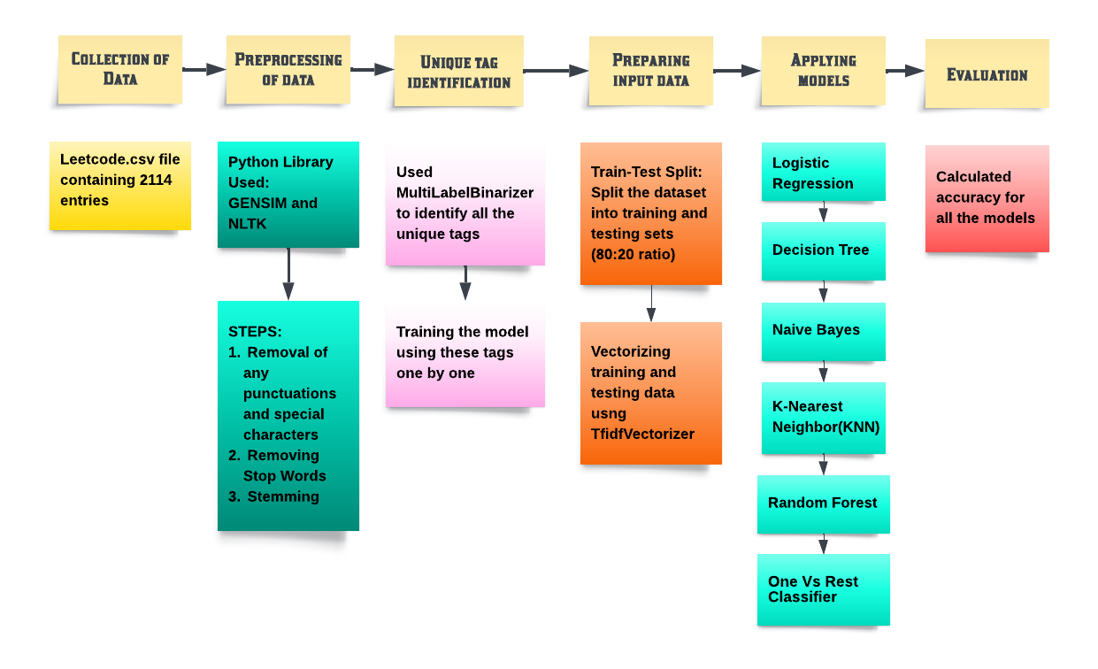
TOPIC DETECTION OF CODING BASED QUESTIONS USING SUPERVISED CLASSIFICATION

Slide 5
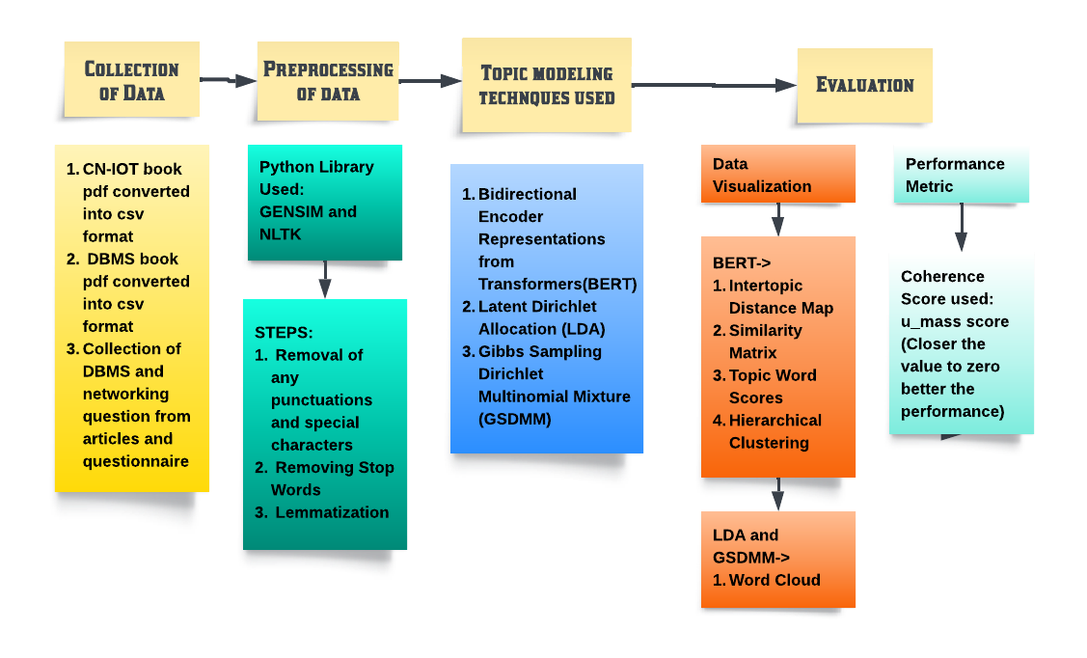
TOPIC DETECTION OF THEORETICAL QUESTIONS USING UNSUPERVISED CLASSIFICATION

Slide 6
PROPOSED METHODOLOGY
Collection of data:
Collected a dataset of coding questions asked in interviews from various companies.
Extracted problem statement with their tags from the database of the leetcode using the title slug present in the links of the coding questions, where title slug corresponds to the particular coding problem
Collected theoretical questions on DBMS and networking from various sources, such as books or online materials.
Collected books on DBMS and CN.

Slide 7
PROPOSED METHODOLOGY
2. Preprocessing of data:
Preprocessed and cleaned the collected data by removing stop words, stemming, and handling any missing values.
Used MultiLabelBinarizer to handle the multi-label nature of the tags and created a dataset with problem statements and corresponding tag frequencies.
Converted the text data into numerical vectors using CountVectorizer to prepare it for machine learning algorithms.
Preprocessed the theoretical question data by cleaning, removing stop words, and performing any necessary text transformations.
Used the preprocessed data from books on DBMS and networking to fine-tune the BERT model for topic prediction.

Slide 8
PROPOSED METHODOLOGY
3. Applying algorithms for topic modelling and cluster of topics:
Split the dataset into training and testing sets for supervised learning analysis.
Applied machine learning algorithms such as Logistic Regression, Decision Trees, Naive Bayes, KNN, Random Forest and One-vs-Rest Classifier to classify coding questions based on their tags.
Utilized unsupervised learning techniques like BERT, LDA, or GSDMM to cluster the preprocessed theoretical questions into potential topics.
Applied the trained BERT model to predict topics matching the questions asked in interviews.

Slide 9
PROPOSED METHODOLOGY
4. Performance evaluation:
Evaluated the performance of each algorithm by calculating accuracy and other relevant metrics.
Evaluated the quality of the clustering using measures such as coherence analysis.
Represented the frequency of each topic asked in specific companies using visualizations like word clouds and plots.
Conducted a comparative analysis of the different algorithms and models used in the project to determine their effectiveness and suitability for question analysis.
Summarized the findings, insights, and trends discovered through the analysis of coding and theoretical questions.

Slide 10
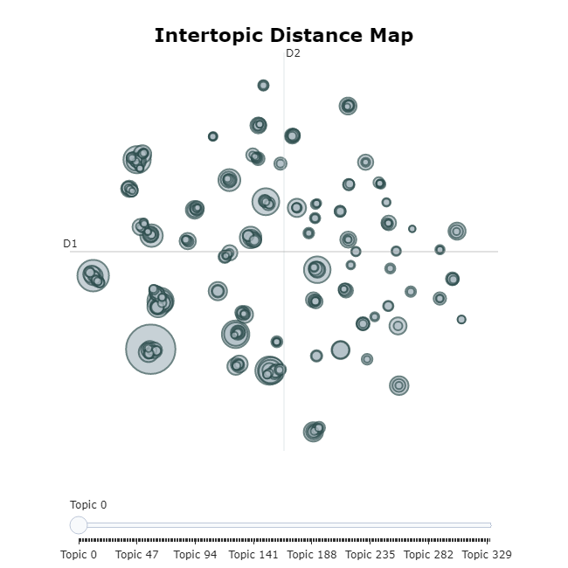
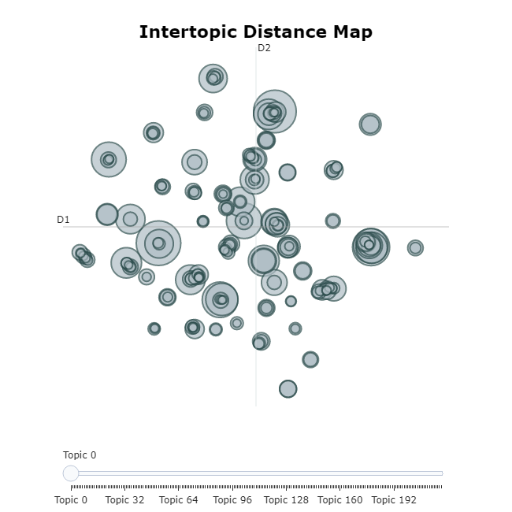
RESULTS
Intertopic Distance Map of topics identified by the BERT model for Computer Networks and DBMS
Intertopic Distance Map of topics identified by the BERT model for Computer Networks subject
Intertopic Distance Map of topics identified by the BERT model for DBMS subject

Slide 11
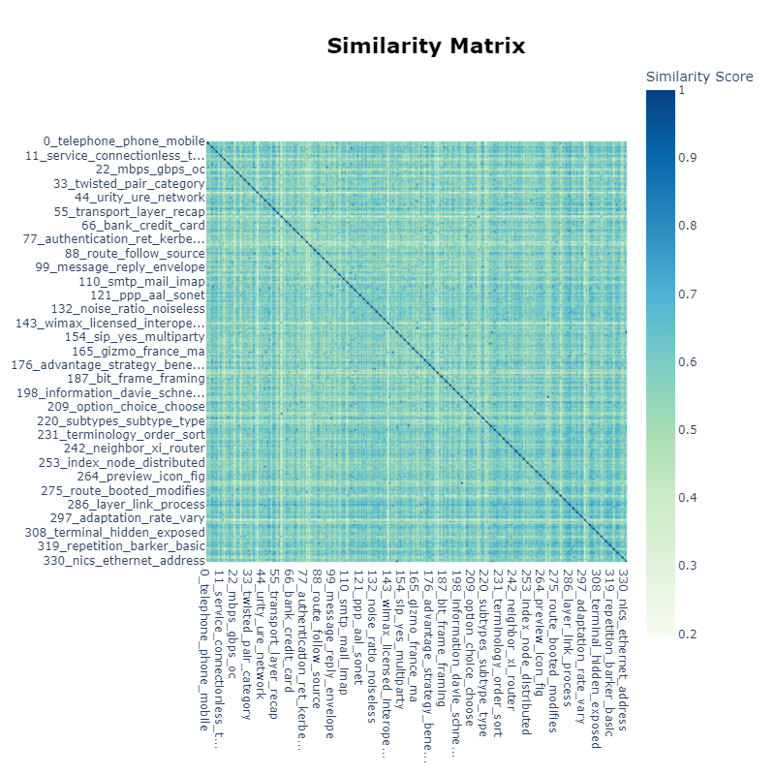
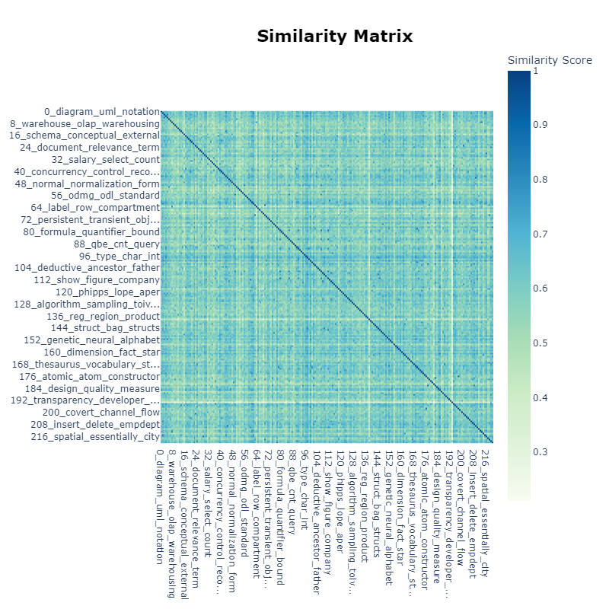
Similarity Matrix of topics identified by the BERT model for Computer Networks and DBMS
Similarity Matrix of topics identified by the BERT model for Computer Networks subject
Similarity Matrix of topics identified by the BERT model for DBMS subject

Slide 12
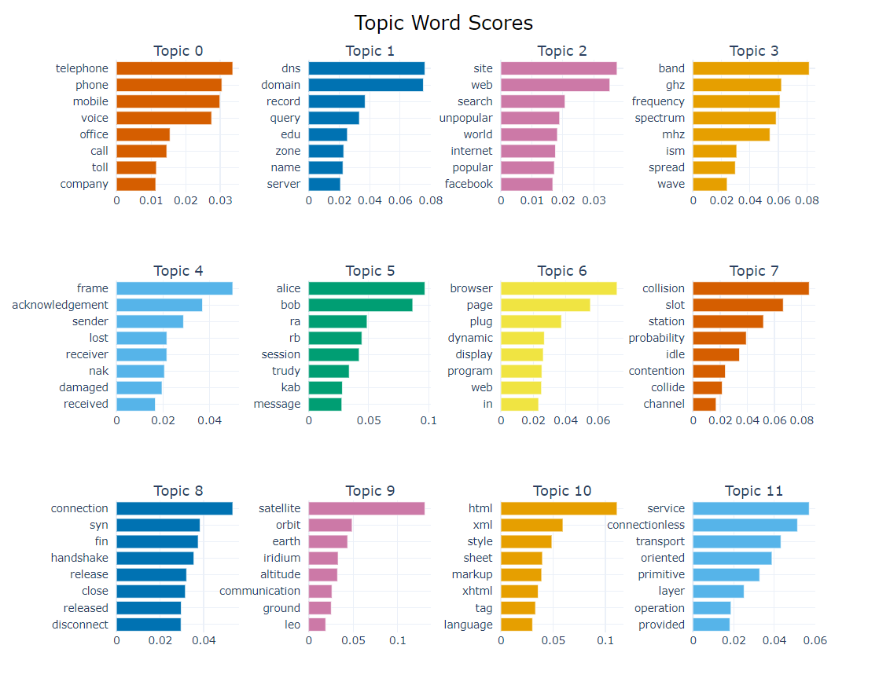
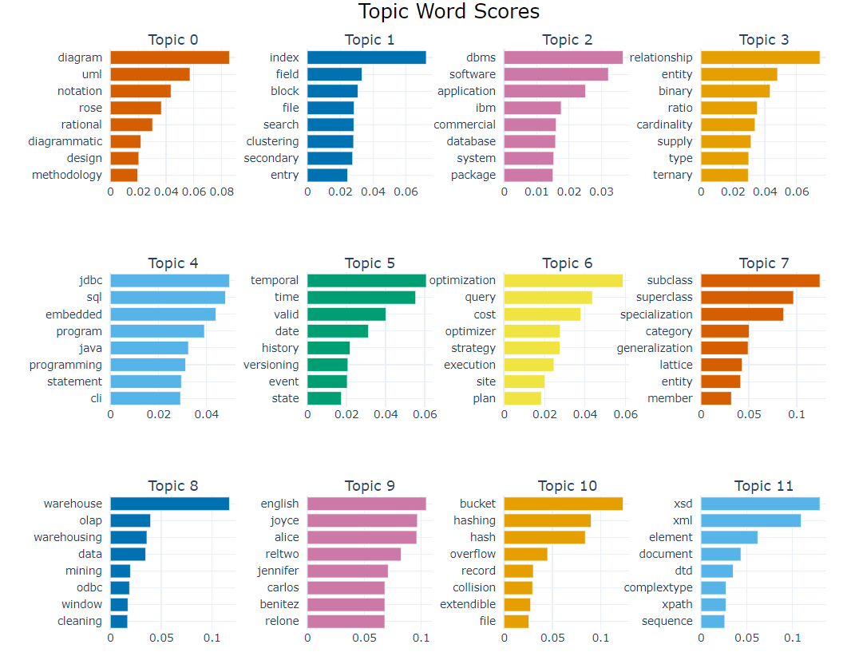
Topic Word Score of topics identified by the BERT model for Computer Networks and DBMS
Topic Word Score of topics identified by the BERT model for Computer Networks subject
Topic Word Score of topics identified by the BERT model for DBMS subject

Slide 13
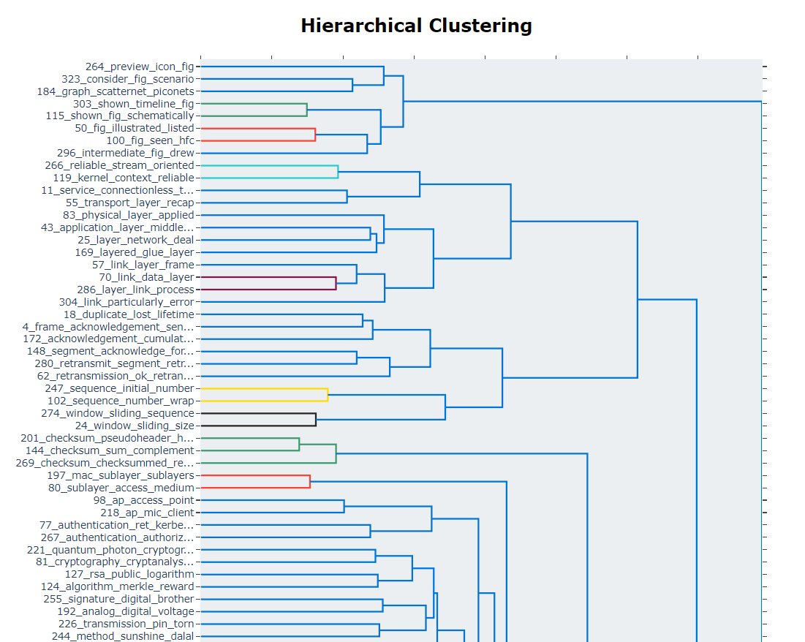
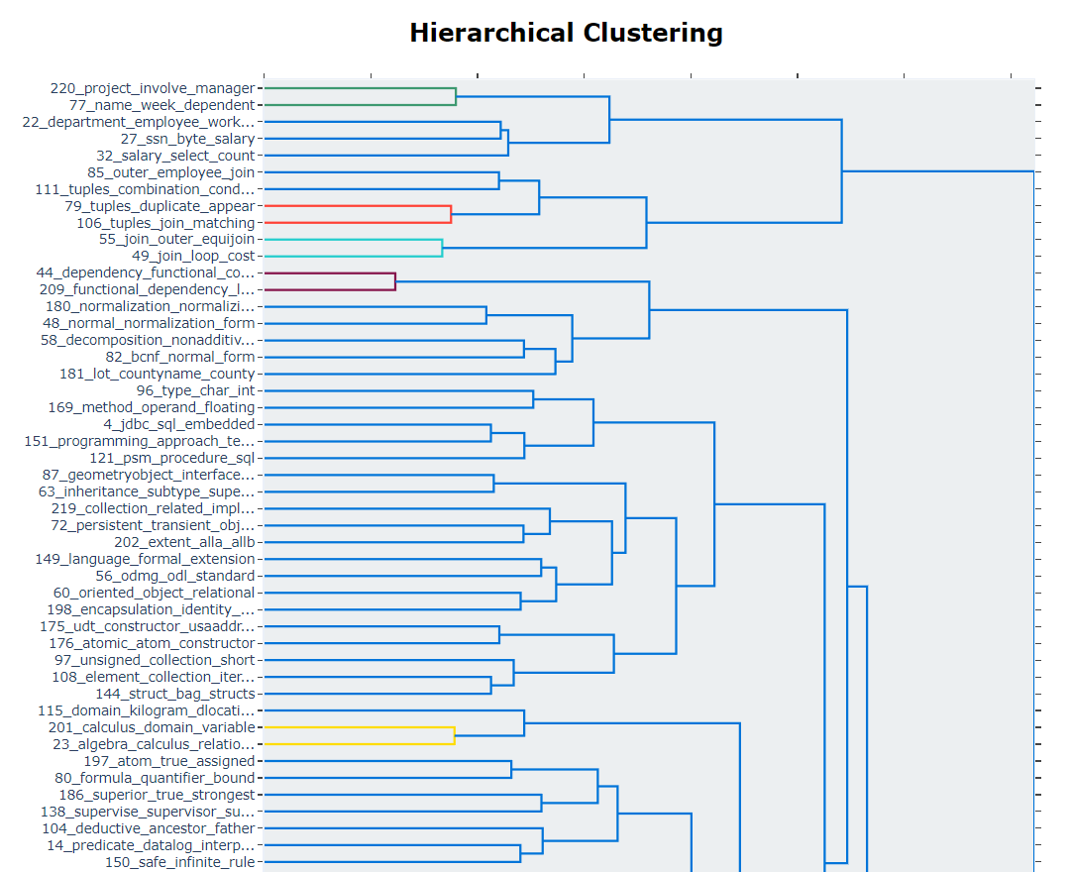
Hierarchical Clustering of topics identified by the BERT model for Computer Networks and DBMS
Hierarchical Clustering of topics identified by the BERT model for Computer Networks subject
Hierarchical Clustering of topics identified by the BERT model for DBMS subject

Slide 14
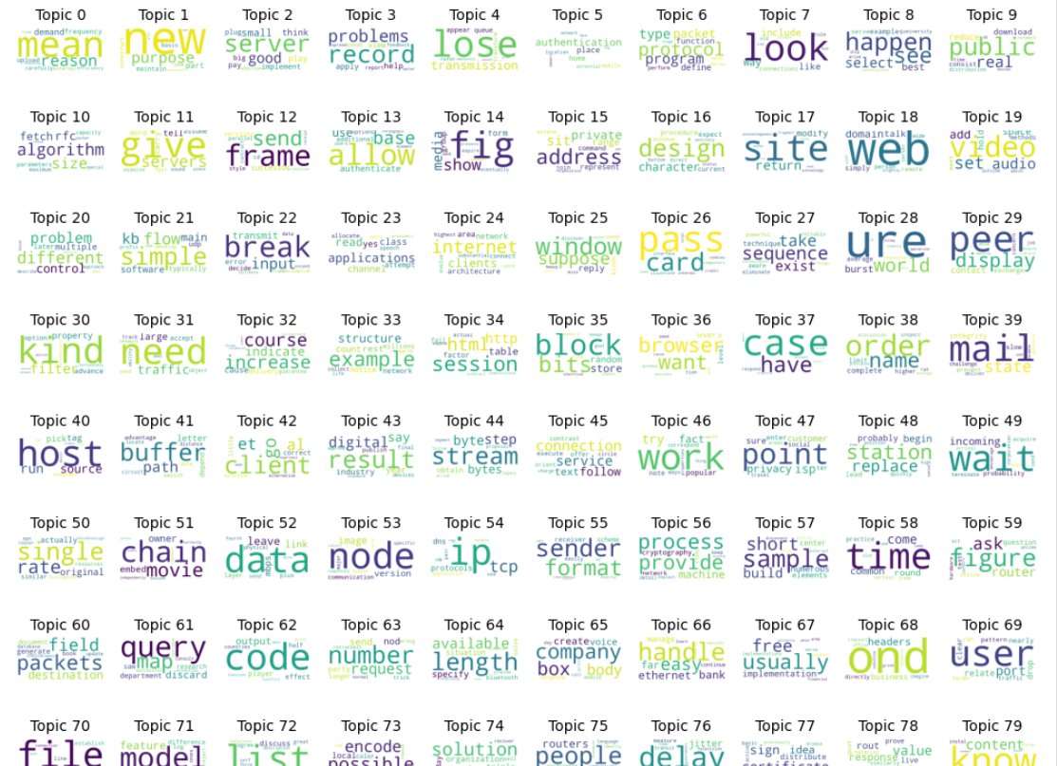
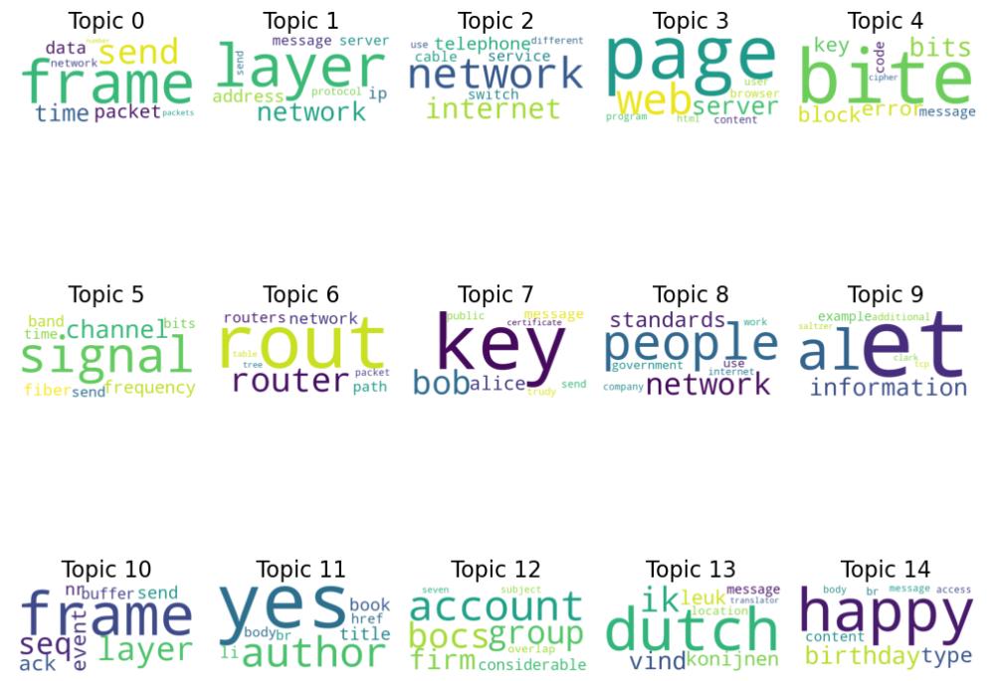
Topic Extraction result by LDA and GSDMM for Computer Networks
GSDMM for computer networks
LDA for Computer Networks

Slide 15
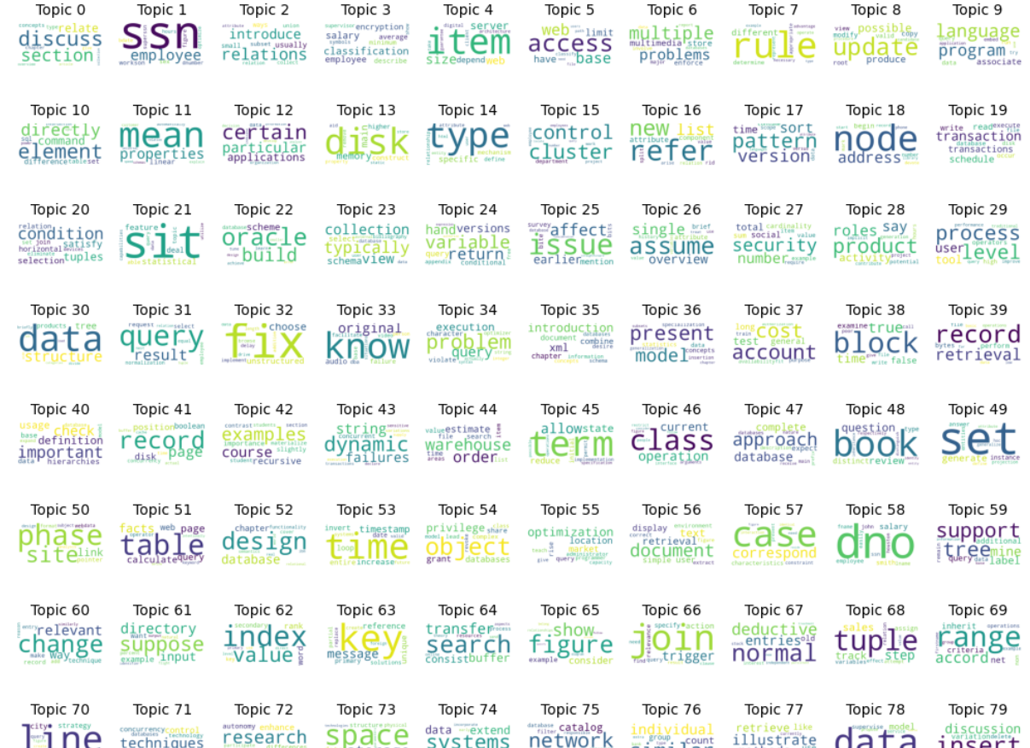
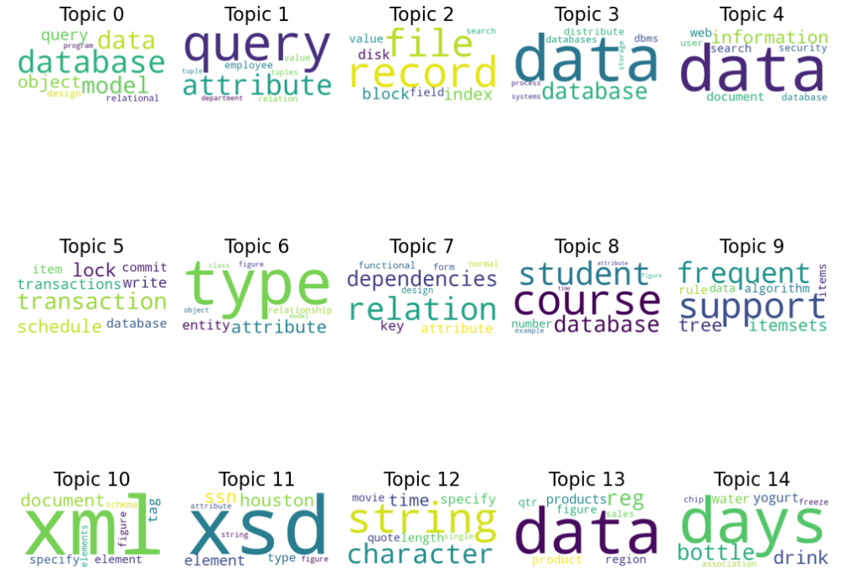
Topic Extraction result by LDA and GSDMM for DBMS
GSDMM for DBMS
LDA for DBMS

Slide 16
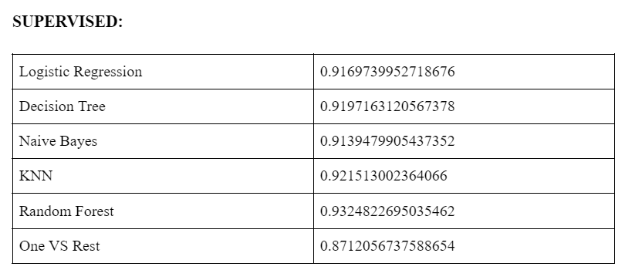
RESULTS
ACCURACY SCORE

Slide 17
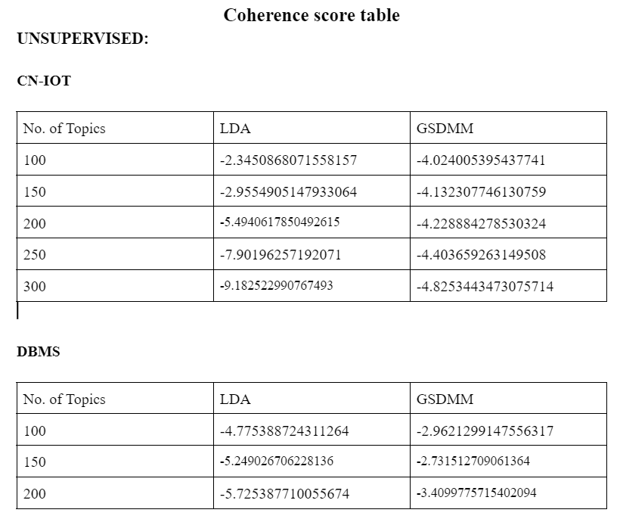
RESULTS
COHERENCE SCORE TABLE

Slide 18
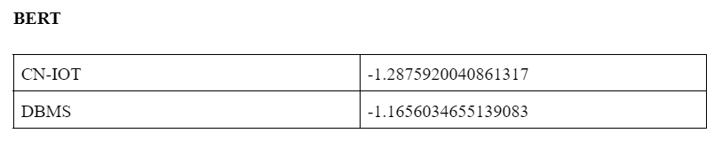
RESULTS
COHERENCE SCORE TABLE

Slide 19
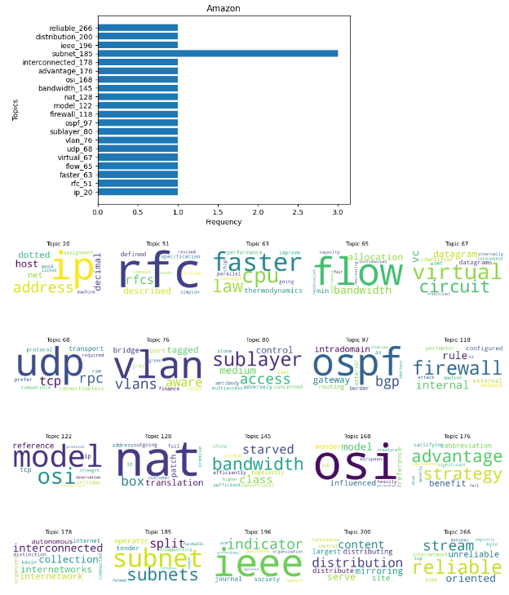
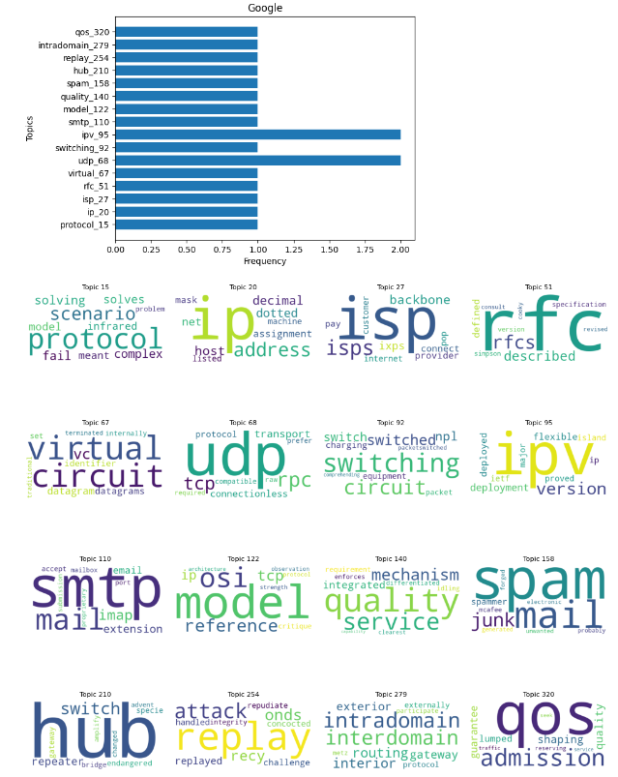
PREDICTING TOPIC USING BEST MODEL
Computer Networks topics prediction for Amazon and Google
Used the model which have given the best coherence score to predict the topics of the Computer Networks question. And then representing the frequency of the topics asked by the different company

Slide 20
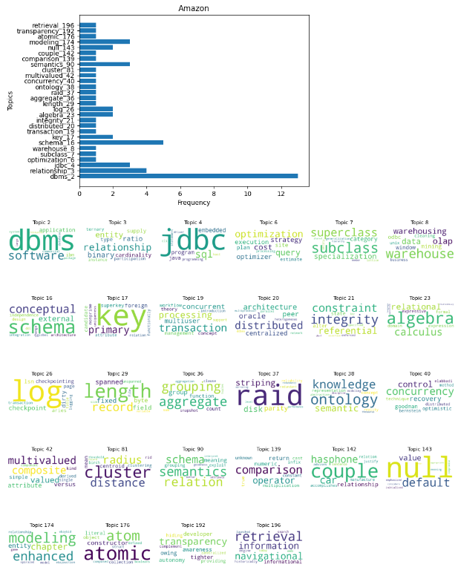
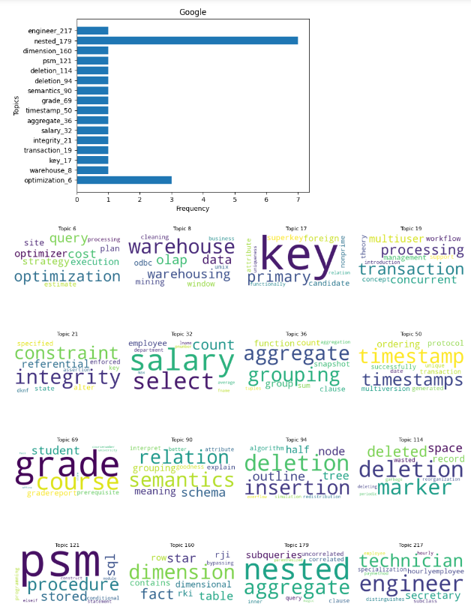
PREDICTING TOPIC USING BEST MODEL
DBMS topics prediction for Amazon and Google
Used the model which have given the best coherence score to predict the topics of the DBMS question. And then representing the frequency of the topics asked by the different company

Slide 21
CONCLUSION
Supervised:
After preprocessing and refining the data we tried implementing many models to classify multi tags one by one. However there is not much significant difference among the models but among all the models Random Forest performed well.
Unsupervised:
In the end , we have been able to obtain different varieties of clusters of topics for the same data.
These clusters of topics are somewhat meaningful in sense but after analyzing different approaches we conclude that using LDA and GSDMM we could not extract significant topics
Further we have analyzed that the BERT works better in extracting topics than LDA and GSDMM in our dataset as it also predicts the topic/cluster very well.
We have extended our study to further link working of this project with DBMS subject, where also we have seen similar outcomes of BERT working better.

Slide 22
THANKS!

